Slide 1
Session 0.1: introductions
Disinformation/Malign Influence Training
SJ Terp & P Breuer, Threet Consulting | 2021

Slide 2
0.1: introductions
What course is about
Introduce instructors (mention AMITT etc)
What students are wanting from the course

Slide 3
Introductions

Slide 4
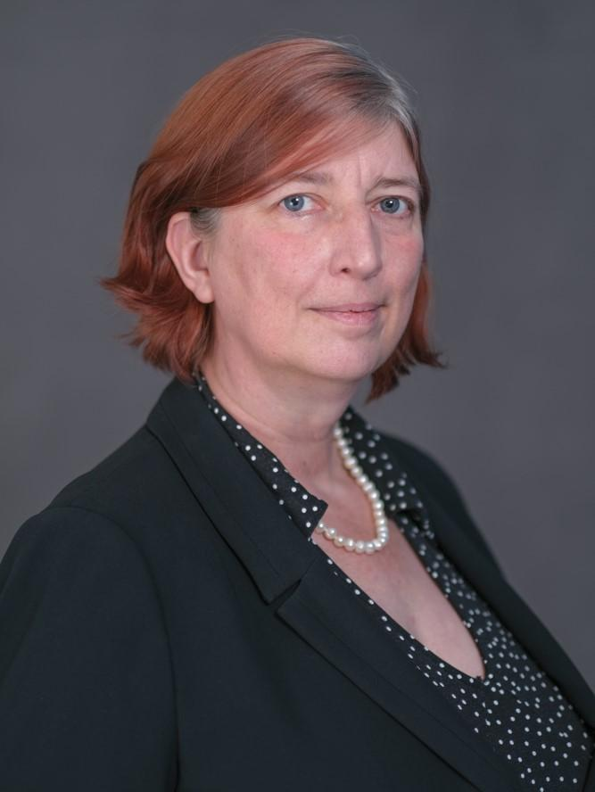
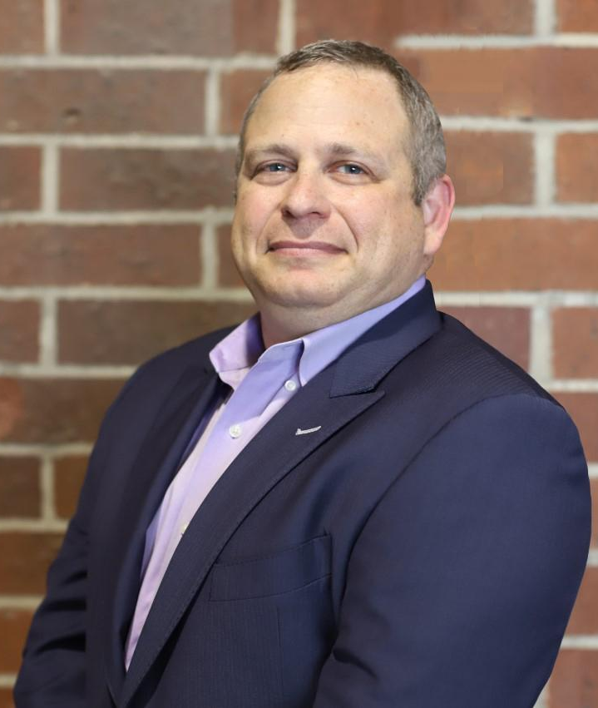
Your Instructors
SJ Terp
Dr. Pablo Breuer

Slide 5
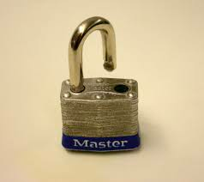
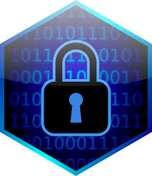

Cognitive Security
PHYSICAL
SECURITY
CYBER
SECURITY
COGNITIVE
SECURITY
Notes:
Cognitive security is the application of information security principles, practices, and tools to misinformation, disinformation, and influence operations. It takes a socio-technical lens to high-volume, high-velocity, and high-variety forms of “something is wrong on the internet”.

Slide 6
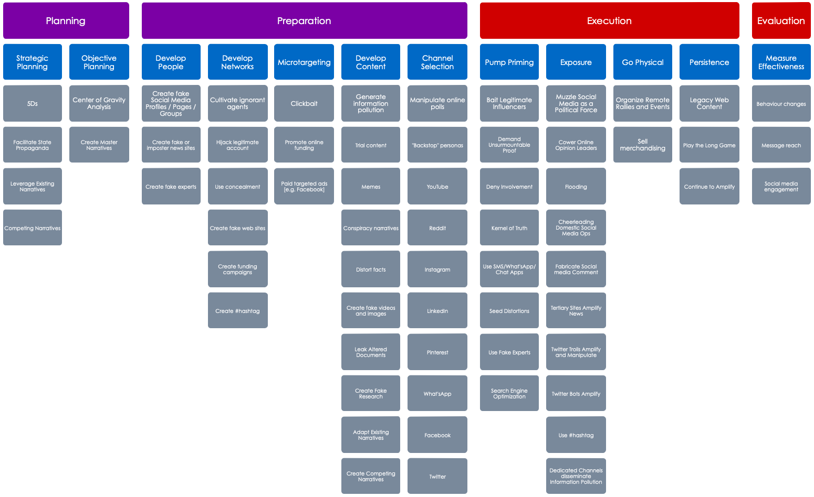
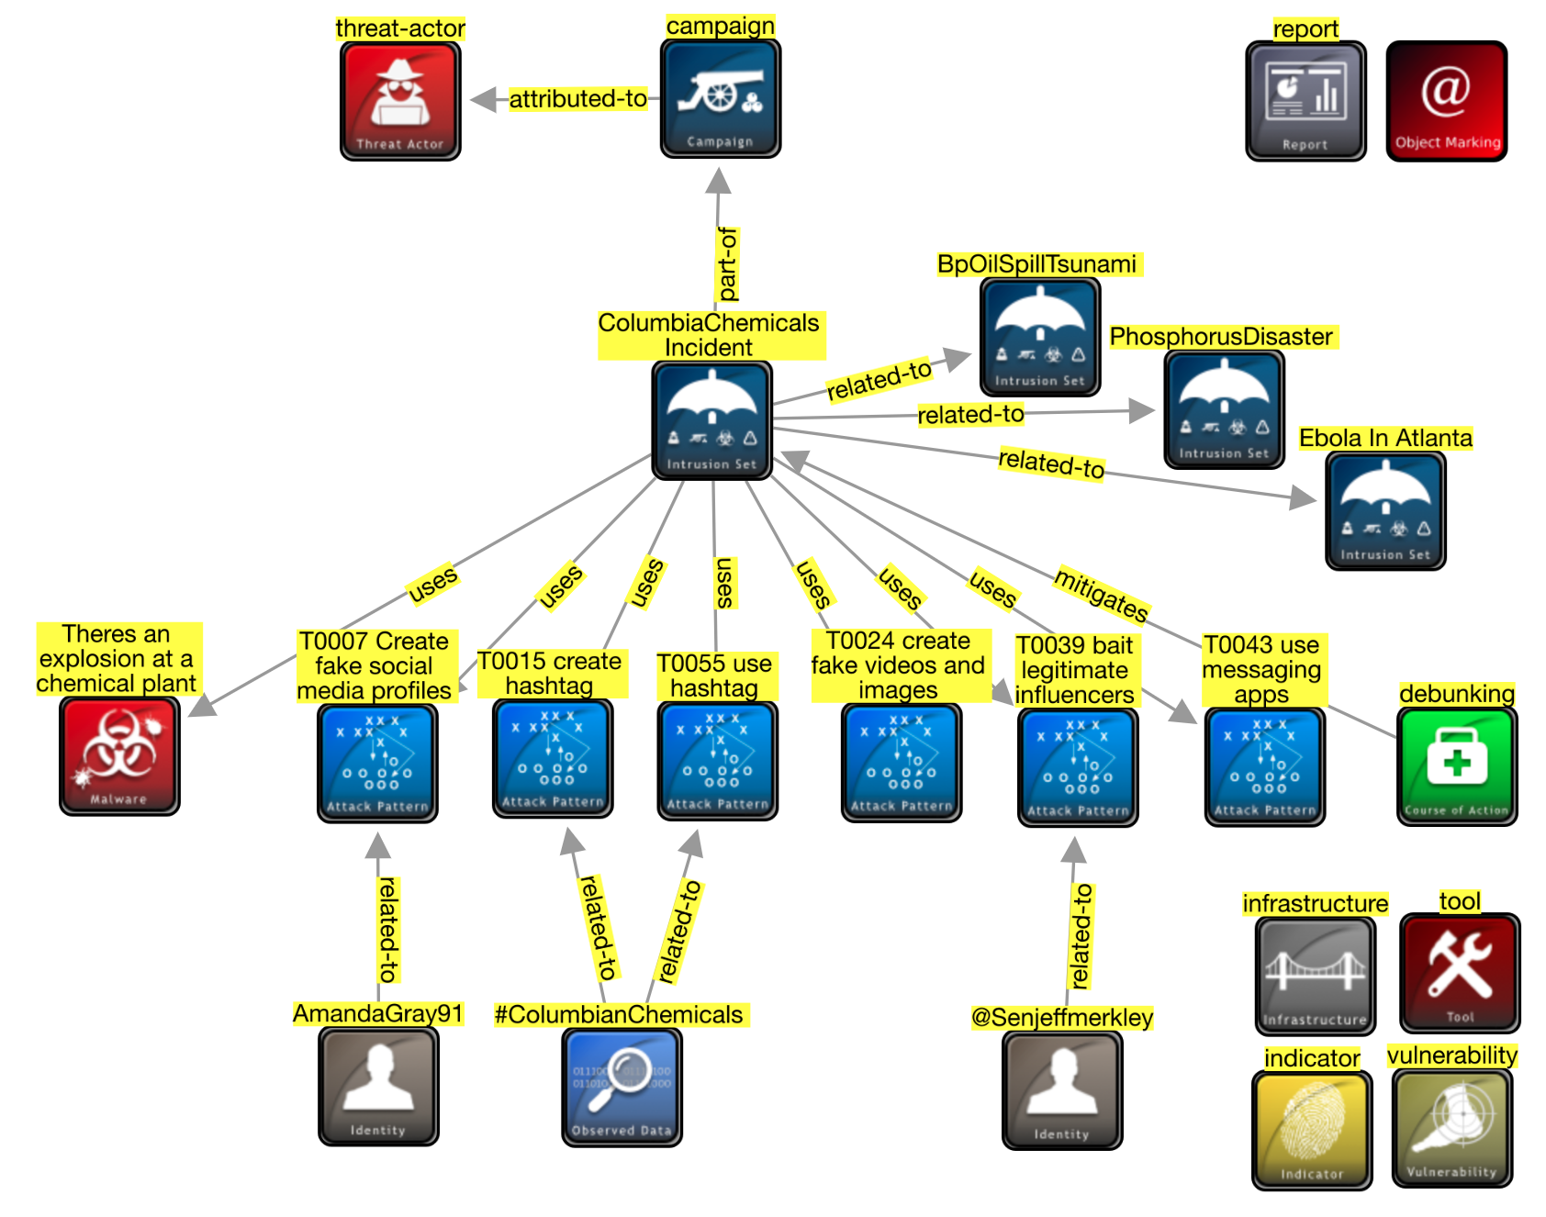
AMITT Frameworks
Planning
Preparation
Execution
Evaluation
Strategic Planning
Objective Planning
Develop People
Develop Networks
Microtargeting
Develop Content
Channel Selection
Pump Priming
Exposure
Go Physical
Persistence
Measure Effectiveness
Have a disinformation response plan
Media literacy through games
Find and train influencers
Remove old and unused accounts
Fill information voids
Hijack content and link to information
Rate-limit engagement
Microtarget likely targets with counter messages
Prebunking
DMCA takedown requests
Poison monitoring and evaluation data
Improve stakeholder coordination
Tabletop simulations
Counter-social engineering training
Unravel Potemkin villages
Stem flow of advertising money
Honeypot social community
Redirect searches away from disinfo
Train journalists to counter influence moves
Humorous counter narratives
Spam domestic actors with lawsuits
Bomb link shorteners with calls
Make civil society more vibrant
Make information provenance available
Ban incident actors from funding sites
Verify project before posting fund requests
Buy more advertising than disinformation creators
Corporate research funding full disclosure
Honeypot: fake engagement system
Tool transparency and literacy in followed channels
Mark content with ridicule / decelerants
Seize and analyse botnet servers
Add random links to network graphs
Red team disinformation, design mitigations
Block access to disinformation resources
Address truth in narratives
Encourage people to leave social media
Reduce political targeting
Real-time updates to factcheck database
Bot to engage and distract trolls
Ask media not to report false info
Expire social media likes/ retweets
Enhanced privacy regulation for social media
Educate influencers
Marginalise and discredit extremist groups
Deplatform message groups and boards
Co-opt disinformation hashtags
Remove non-relevant content from special interest groups
Strengthen verification methods
Repurpose images with counter messages
Influencer disavows misinfo
Platform regulation
Buy out troll farm employees / offer jobs
Ensure platforms are taking down accounts
Stop offering press credentials to disinformation outlets
Mentorship: elders, youth, credit
Content moderation
Verified ids to comment or contribute to poll
Engage payload and debunk
Cut off banking access
Shared fact checking database
Legal action against for-profit engagement farms
Name and shame disinformation influencers
Free open library sources
Prohibit images in political Chanels
Revoke whitelist / verified status
Debunk/ defuse fake expert credentials
Dampen emotional reaction
Repair broken social connections
Develop compelling counter narratives
Denigrate funding recipient / project
Social media source removal
Add metadata to original content
Don’t engage with payloads
Remove / rate limit botnets
Pre-emptive action against disinformation team infrastructure
Run competing campaigns
Infiltrate in-groups
Infiltrate disinformation platforms
Add warning labels on sharing
Hashtag jacking
Social media amber alert
Etc
Etc
Etc
Etc
Etc
Etc
Etc

Slide 7
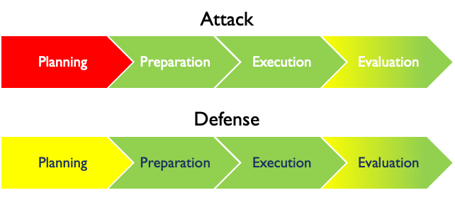
Automating Disinformation by Operational Phase
Notes:
Three Vs
Definitions, MLsec, how this applies to cogsec

Slide 8
Who are you?
Who are you
What are you hoping to get from this course?

Slide 9
Today’s sessions
0: Introductions and definitions
1: history and mechanisms
2: frameworks and risk
3: landscapes and response
4: planning and context analysis
5: response and content analysis
6: simulation and washup

Slide 10
Session 0.2: Definitions
Disinformation/Malign Influence Training
SJ Terp & P Breuer, Threet Consulting | 2021

Slide 11
0.2: Definitions
Introduces contents of the course
History of cognitive security
Working definitions of information operations, disinformation, and cognitive security
Disinformation examples and common myths
Where to find more information
Potential risks to influence operations investigators, and mitigations for them.
Automation and AI

Slide 12
Definitions

Slide 13
Cognitive Security: both of them
“Cognitive Security is the application of artificial intelligence technologies, modeled on human thought processes, to detect security threats.” - XTN
MLSec - machine learning in information security
ML used in attacks on information systems
ML used to defend information systems
Attacking ML systems and algorithms
“Adversarial AI”
“Cognitive Security (COGSEC) refers to practices, methodologies, and efforts made to defend against social engineering attempts‒intentional and unintentional manipulations of and disruptions to cognition and sensemaking” - cogsec.org
CogSec - social engineering at scale
Manipulation of individual beliefs, belonging, etc
Manipulation of human communities
Adversarial cognition
Notes:
What is cognitive security? There are multiple ways to look at this. And unfortunately two disciplines that share the same name - apologies, we didn’t look hard enough when we started socialising the term.
Links:
Left quote from https://xtn-lab.com/what-is-cognitive-security/
Right quote from

Slide 14
Social Engineering: both of them
“the use of centralized planning in an attempt to manage social change and regulate the future development and behavior of a society.”
Mass manipulation etc
“the use of deception to manipulate individuals into divulging confidential or personal information that may be used for fraudulent purposes.”
Phishing etc
Notes:
Definitions from https://languages.oup.com/google-dictionary-en/

Slide 15
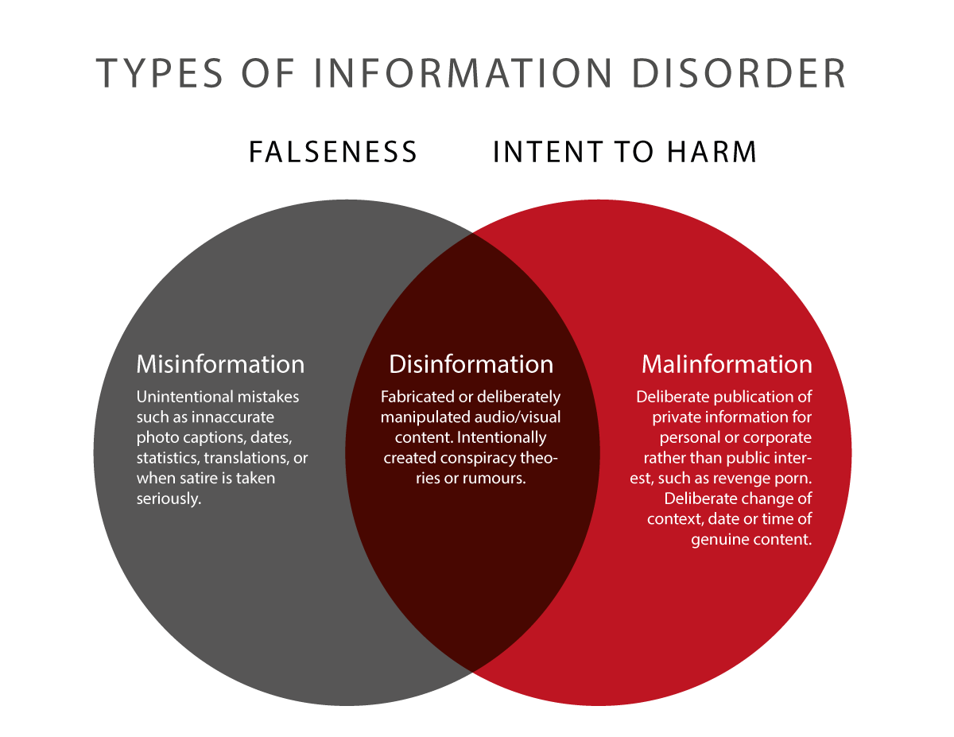
Media: Information disorder

Slide 16
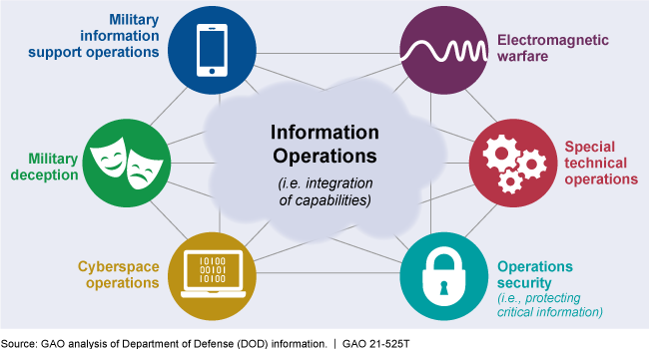
Military: Information Operations

Slide 17
Cognitive Security
PHYSICAL
SECURITY
CYBER
SECURITY
COGNITIVE
SECURITY
Notes:
Cognitive security is the application of information security principles, practices, and tools to misinformation, disinformation, and influence operations. It takes a socio-technical lens to high-volume, high-velocity, and high-variety forms of “something is wrong on the internet”.
Cognitive security can be seen as a holistic view of disinformation from a security practitioner’s perspective.

Slide 18
Information Security vs Cognitive Security: Objects
Computers
Networks
Internet
Data
Actions
People
Communities
Internet
Beliefs
Actions

Slide 19
CIA: Disinformation as an Integrity problem
Confidentiality: only the people/systems that are supposed to have the information do
Integrity: the information has not been tampered with
Availability: people can use the system as intended
Notes:
Danny Rogers, Black Hat / Forbes

Slide 20
What We’re Dealing With

Slide 21
Environment
Too much information
Big data’s “3 Vs”: velocity, volume, variety
Inaccurate information
Rumours, misinformation, disinformation, conspiracy theories
Digital harms
Physical, economic, psychological, reputational, social, societal
Trust management
Shift from increasing trust to managing trust and its erosion
Notes:
Harms: Agrafiotis

Slide 22
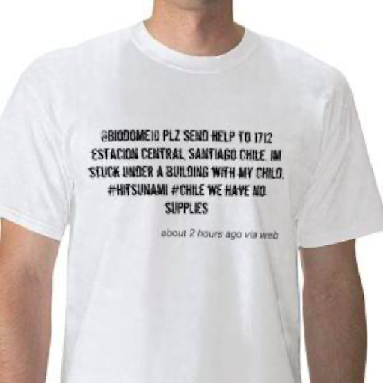
Simple attention-grabbing
Notes:
Image: 2010 red cross t-shirt

Slide 23
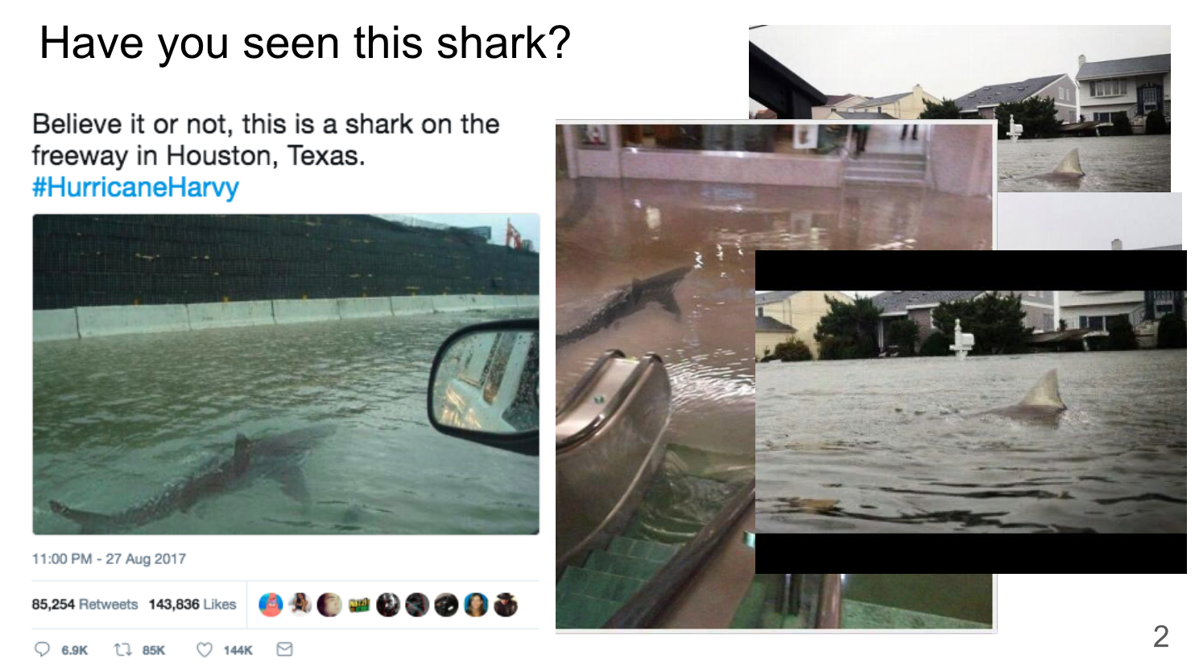
Repeated attention-grabbing

Slide 24
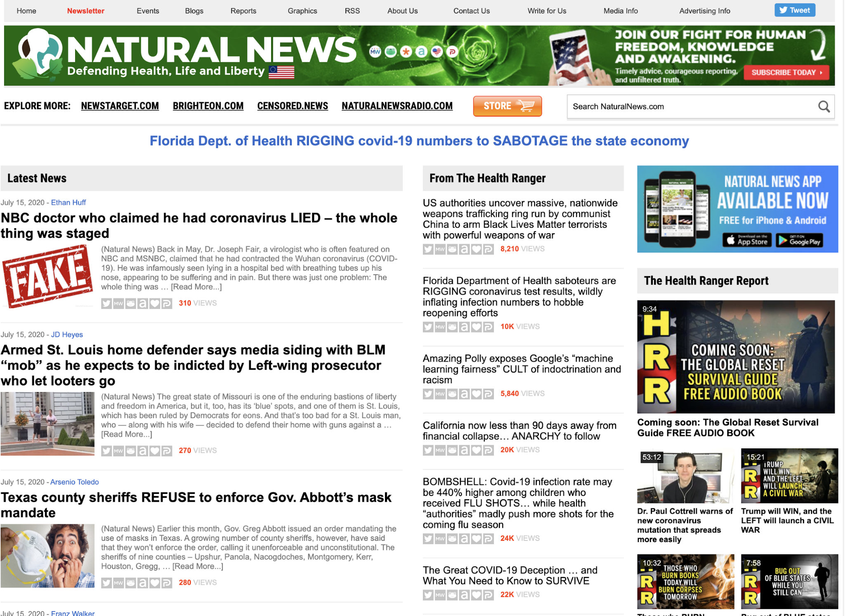
Financial

Slide 25
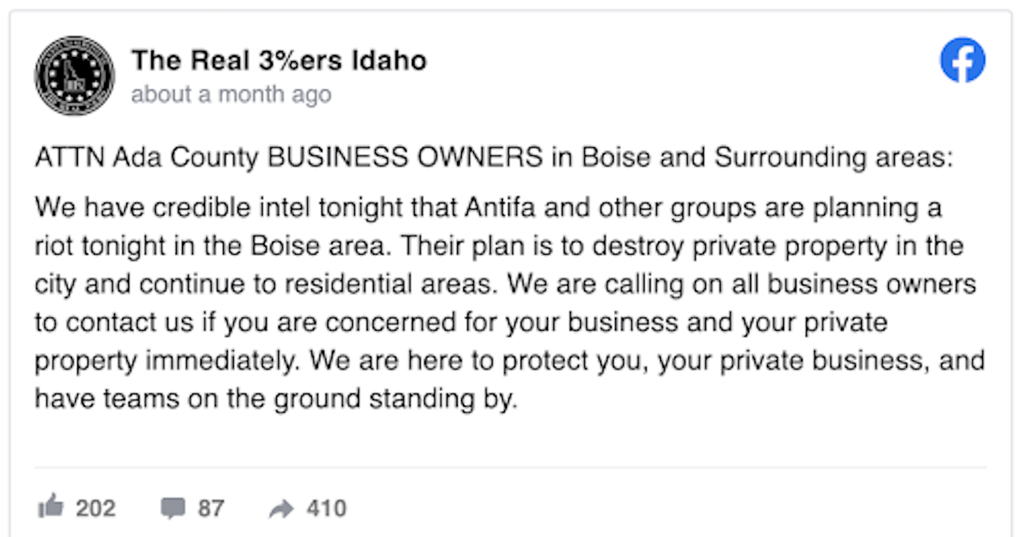
Boosting extremism

Slide 26
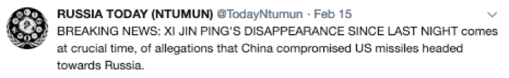
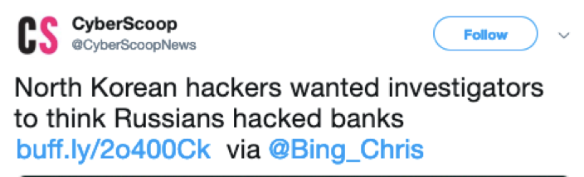
Geopolitical

Slide 27
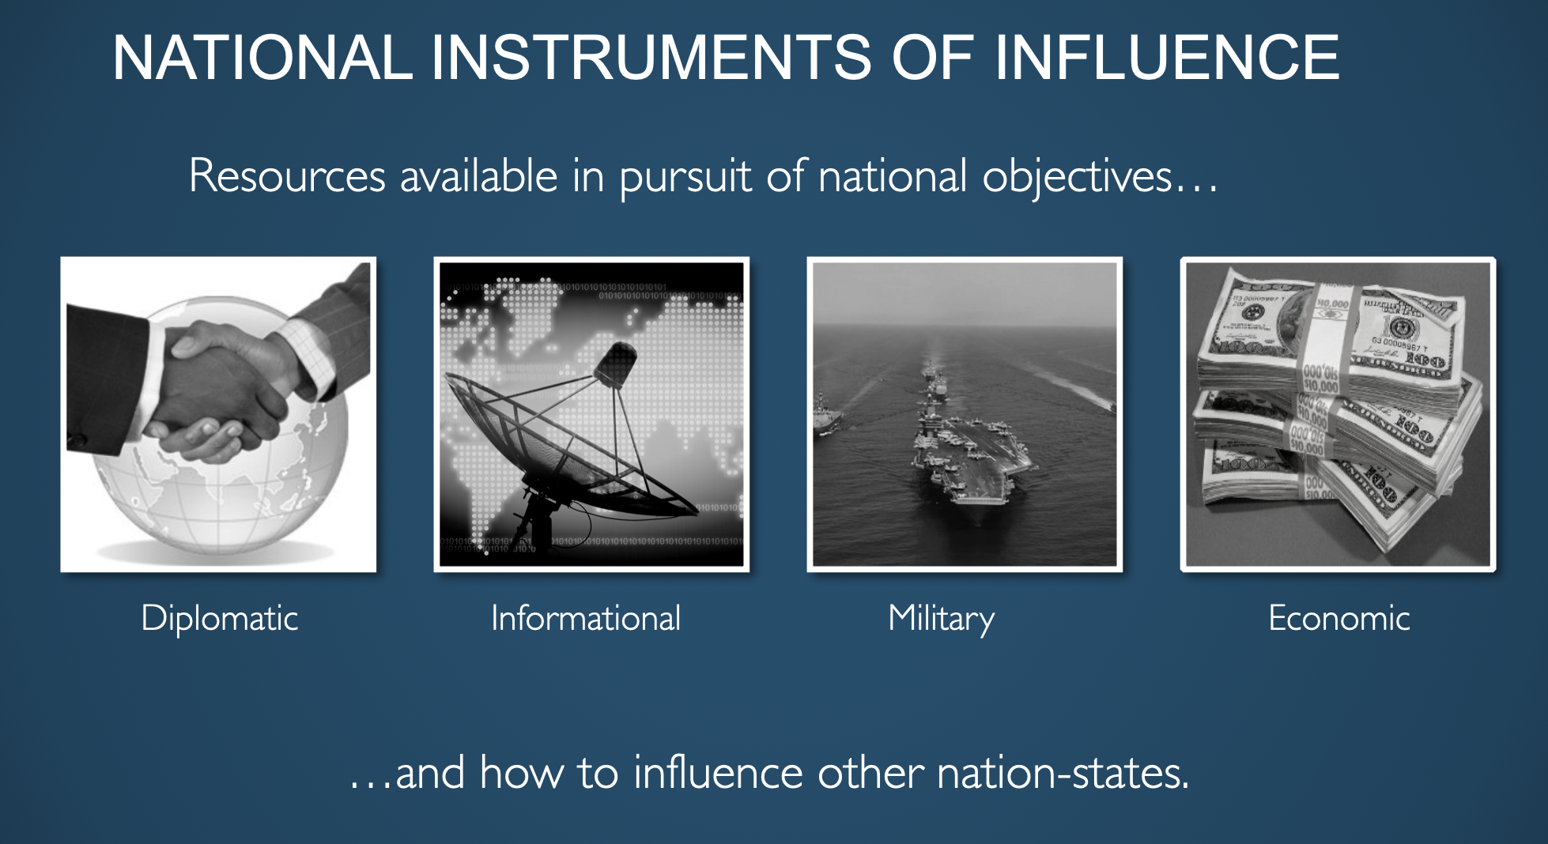
Because it’s a good way to get what you want…

Slide 28
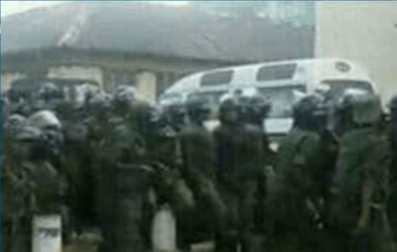
With real-world effects

Slide 29
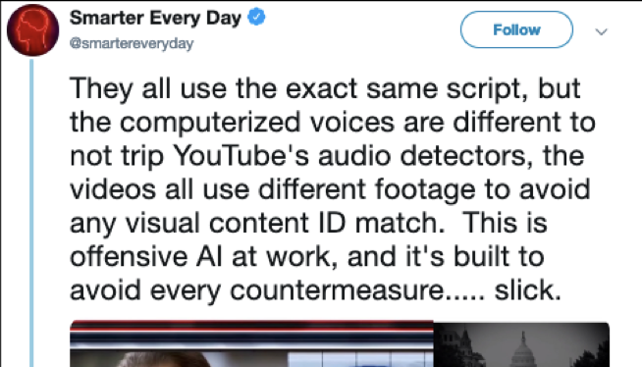
Using automation

Slide 30
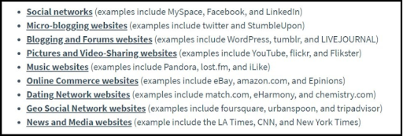
On every platform
Notes:
Image: Chris Burgess

Slide 31
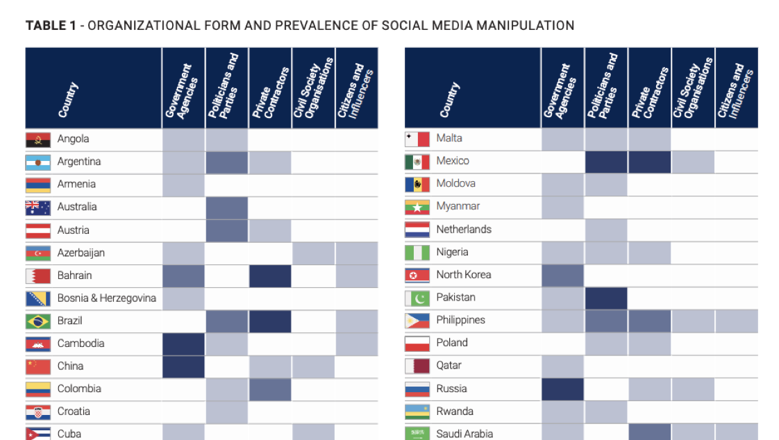
Every Country
Notes:
Table: Computational Propaganda
Good places to look for countries
https://euvsdisinfo.eu/disinformation-cases/ - Russia disinfo on EU
https://medium.com/dfrlab - world disinfo
https://comprop.oii.ox.ac.uk/ - nationstate actors
Specifically The Global Disinformation Order and https://comprop.oii.ox.ac.uk/wp-content/uploads/sites/93/2019/09/Case-Studies-Collated-NOV-2019-1.pdf
https://www.newsguardtech.com/covid-19-resources/ - c19 domains for several countries

Slide 32
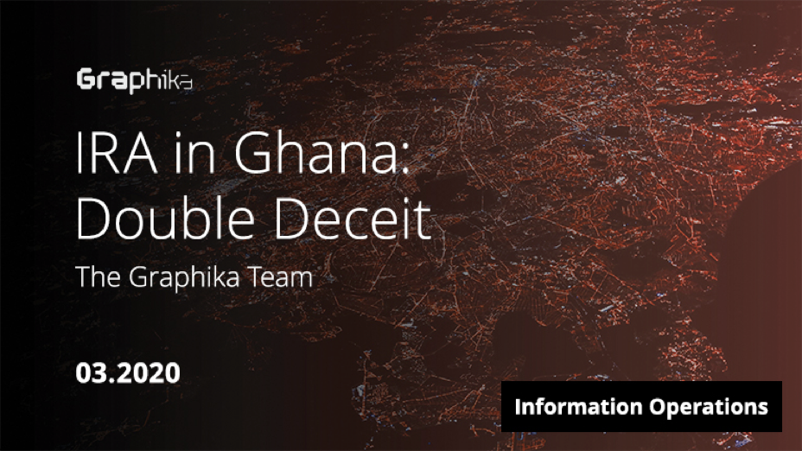
Outsourcing

Slide 33
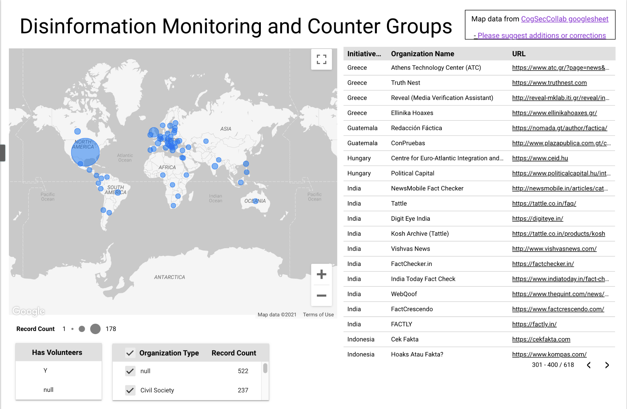
But also 1000s of responders

Slide 34
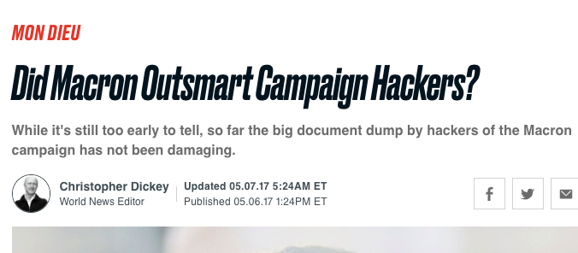
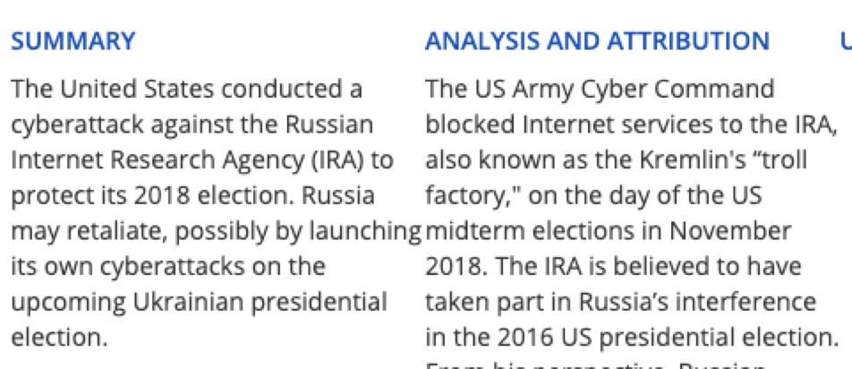
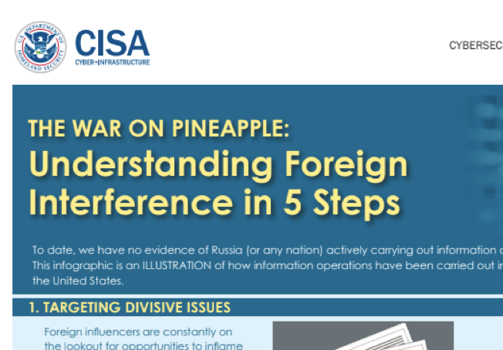
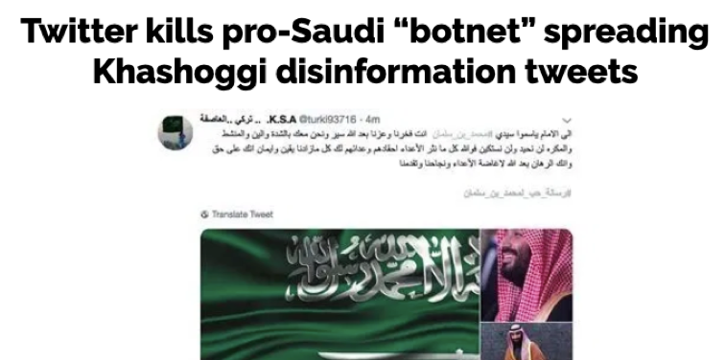
At different scales

Slide 35
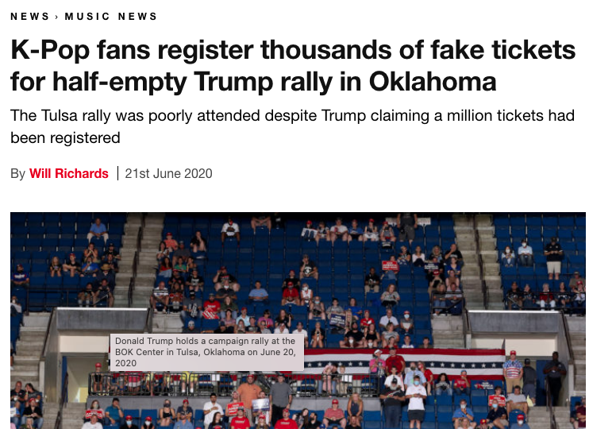
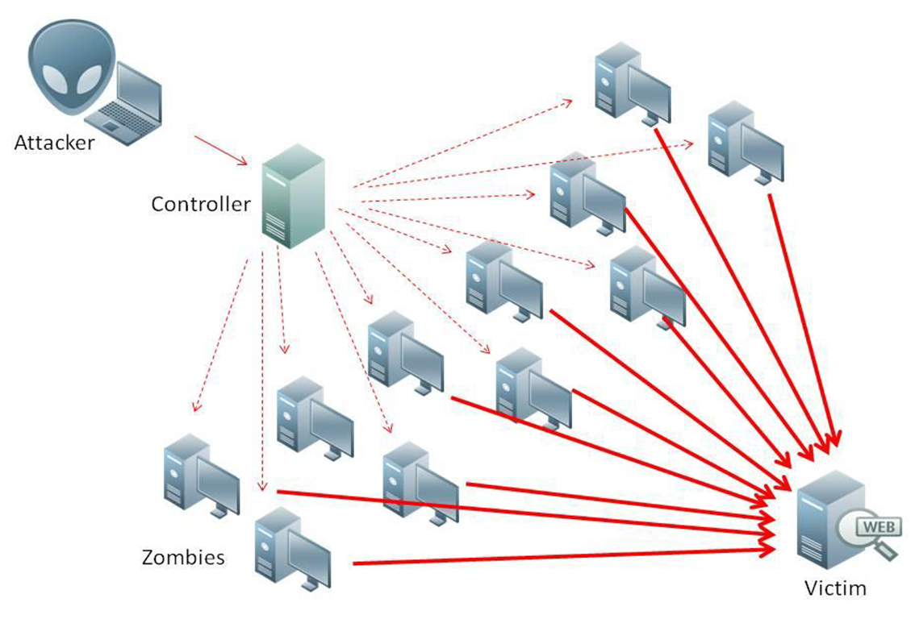
Including Denial of Service
Make a system inaccessible
Distributed denial of service (DDOS): use a lot of machines to do this, so the attack appears to come from many places
Notes:
Image: wikipedia https://commons.wikimedia.org/wiki/File:Ddos-attack-ex.png
Example include flooding the site with traffic.
k-Pop fans flooding Trump booking site: see https://sec.okta.com/articles/2020/10/kpop-fans-non-traditional-non-state-actors

